Slide 1
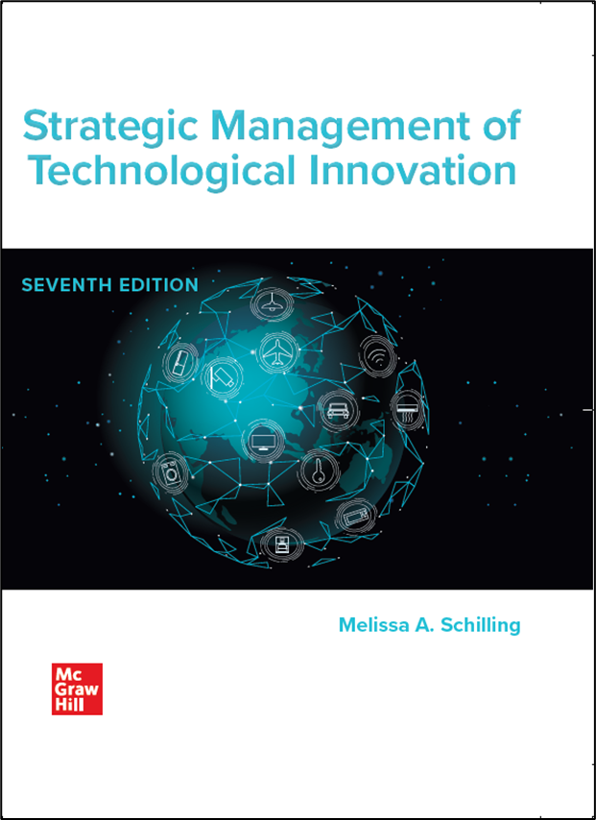
Chapter 6
Defining the Organization's Strategic Direction
Strategic Management of Technological Innovation, 7th Edition
Melissa A. Schilling
© McGraw Hill LLC. All rights reserved. No reproduction or distribution without the prior written consent of McGraw Hill LLC.

Slide 2
Tesla, Inc. in 2021
Tesla was founded in 2003 by Martin Eberhard, an entrepreneur who wanted to create a faster, sexier electric car. In 2004, Elon Musk agreed to fund the company and became Chairman of the Board. A few years later Eberhard left and Musk became C E O.
In 2021, Tesla had grown into a company with almost $32 billion in annual revenues that produced multiple car models, owned Solar City, produced energy storage systems (for example, Powerwall) and solar roofs. Tesla had additionally announced several future products, including trucks, a new sports car, and a full self-driving system.
The company’s expansion into multiple product lines and rapid production capacity expansion created large capital requirements for the firm.
Tesla’s cars had rapidly attracted a large and loyal fan base and sales were growing at an impressive rate. But was Tesla trying to do too much too quickly?

Slide 3
Reinventing Hotels: citizenM
Discussion Questions:
What were Musk’s and Eberhard’s goals in founding Tesla?
How would you characterize competition in the auto industry?
What do you think are Tesla’s core competencies? Does it have any sources of sustainable competitive advantage?
What is your assessment of Tesla’s moves into (a) mass-market cars, (b) batteries (car batteries and Powerwall), (c) solar panels? Please consider both the motivation for the moves, and the opportunities and challenges for Tesla to compete in these businesses.
Do you think Tesla will be profitable in all of these businesses? Why or why not?
What do you think Tesla’s (or Elon Musk’s) strategic intent is?

Slide 4
Overview
A coherent technological innovation strategy leverages the firm’s existing competitive position and provides direction for future development of the firm.
Formulating this strategy requires:
Appraising the firm’s environment.
Appraising the firm’s strengths, weaknesses, competitive advantages, and core competencies.
Articulating an ambitious strategic intent.

Slide 5
Assessing the Firm’s Current Position 1
External Analysis.
Two common methods are Porter’s Five-Force Model and Stakeholder Analysis.
Porter’s Five-Force Model.
Degree of existing rivalry. Determined by number of firms, relative size, degree of differentiation between firms, demand conditions, exit barriers.
Threat of potential entrants. Determined by attractiveness of industry, height of entry barriers (for example, start-up costs, brand loyalty, regulation, etc.).
Bargaining power of suppliers. Determined by number of suppliers and their degree of differentiation, the portion of a firm’s inputs obtained from a particular supplier, the portion of a supplier’s sales sold to a particular firm, switching costs, and potential for vertical integration.

Slide 6
Assessing the Firm’s Current Position 2
Bargaining power of buyers. Determined by number of buyers, the firm’s degree of differentiation, the portion of a firm’s inputs sold to a particular buyer, the portion of a buyer’s purchases bought from a particular firm, switching costs, and potential for vertical integration.
Threat of substitutes. Determined by number of potential substitutes, their closeness in function and relative price.
Recently Porter has acknowledged the role of complements. Must consider:
a. how important complements are in the industry.
b. whether complements are differentially available for the products of various rivals (impacting the attractiveness of their goods), and
c. who captures the value offered by the complements.

Slide 7
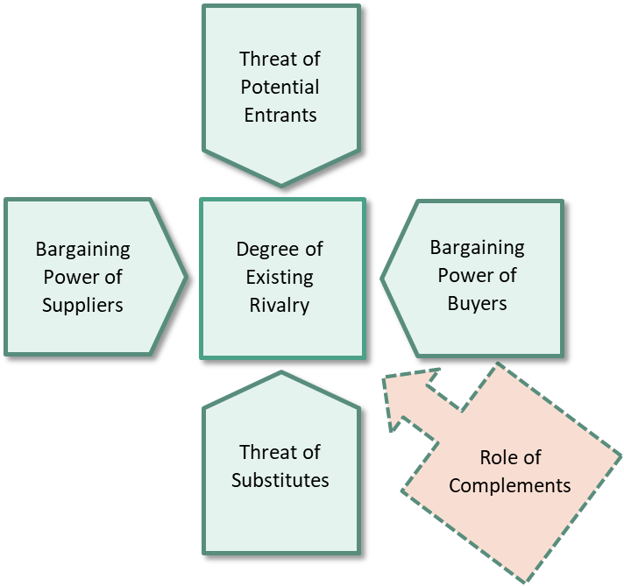
Assessing the Firm’s Current Position 3
Five-Force Model plus Complements.
Source: Adapted from Michael Porter, Competitive Strategy: Techniques for Analyzing Industries and Competitors.
Access the text alternative for these images.

Slide 8
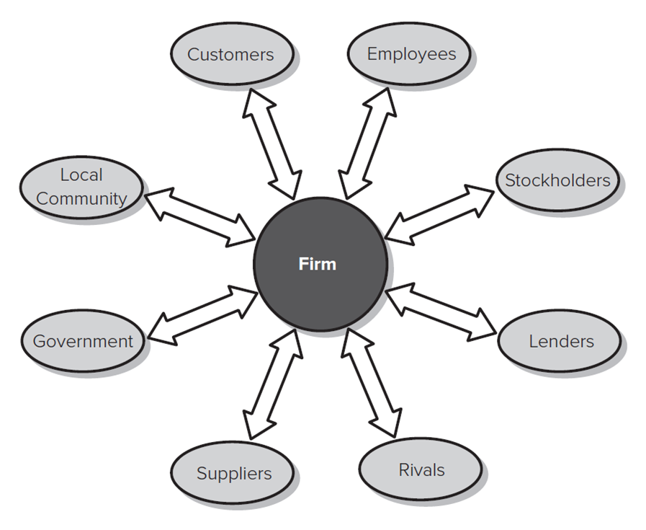
Assessing the Firm’s Current Position 4
Stakeholder Analysis.
Who are the stakeholders?
What does each stakeholder want?
What resources do they contribute to the organization?
What claims are they likely to make on the organization?
Access the text alternative for these images.

Slide 9
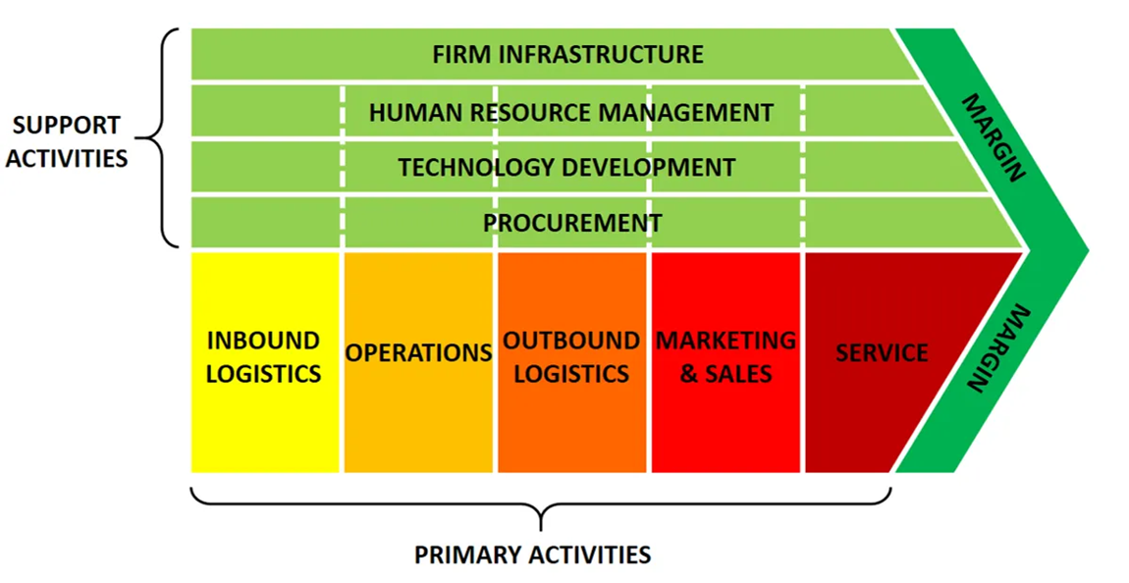
Assessing the Firm’s Current Position 5
Internal Analysis.
Identify the firm’s strengths and weaknesses. It’s helpful to consider each element of value chain.
Source: Michael Porter, Competitive Advantage: Creating and Sustaining Superior Performance.
Access the text alternative for these images.

Slide 10
Research Brief
Using Big Data to Guide Innovation.
In the last decade, massive advancements in digitalization have led to the creation of huge datasets – “big data.” Effective utilization of such data, however, requires good data analysis strategies and practices.
In his book, Data Science for Business, Foster Provost offers tips for making data science valuable in the organization:
Treat data as assets.
Managers must take the building and composition of the data science team very seriously.
Differentiate between the business opportunities and challenges facing the firm, and the data analytics questions that you pose (that is, they are not the same.
Assess how representative, accurate and reliable the data are

Slide 11
Assessing the Firm’s Current Position 6
Assess which strengths have potential to be sustainable competitive advantage.
Rare.
Valuable.
Durable.
Inimitable.
Sustainable Competitive Advantage
Competitive Advantage
Resources are difficult (or impossible) to imitate when they are:
Tacit.
Path dependent.
Socially complex.
Causally ambiguous.

Slide 12
Identifying Core Competencies and Capabilities 1
Core Competencies: A set of integrated and harmonized abilities that distinguish the firm in the marketplace.
Competencies typically combine multiple kinds of abilities.
Several core competencies may underlie a business unit.
Several business units may draw from same competency.
Core competencies should:
Be a significant source of competitive differentiation.
Cover a range of businesses.
Be hard for competitors to imitate.

Slide 13
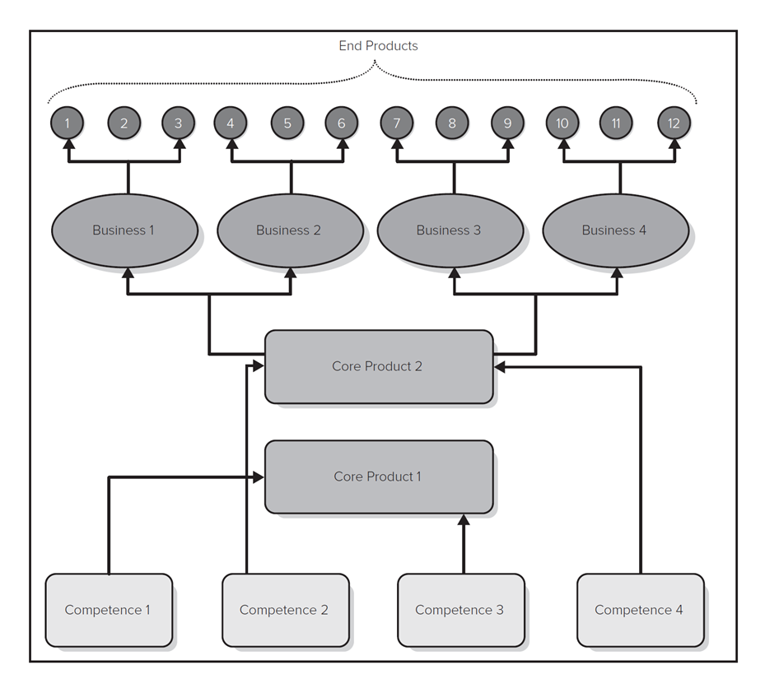
Identifying Core Competencies and Capabilities 2
Source: C. K. Prahalad and G. Hamel, “The Core Competence of the Corporation,” Harvard Business Review, May–June 19 90.
Access the text alternative for these images.

Slide 14
Risk of Core Rigidities
When firms excel at an activity, they can become over committed to it and rigid.
Incentives and culture may reward current competencies while thwarting development of new competencies.
Dynamic capabilities are competencies that enable the firm to quickly respond to change.
For example, firm may develop a set of abilities that enable it to rapidly deploy new product development teams for a new opportunity; firm may develop competency in working with alliance partners to gain needed resources quickly.

Slide 15
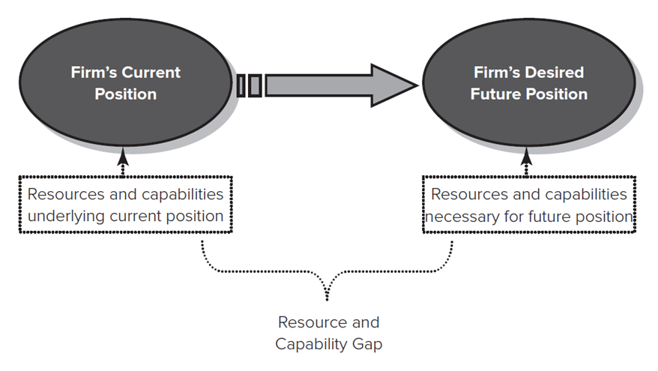
Strategic Intent
Strategic Intent.
A long-term goal that is ambitious, builds upon and stretches firm’s core competencies, and draws from all levels of the organization.
Typically looks 10 to 20 years ahead, establishes clear milestones.
Firm should identify resources and capabilities needed to close gap between strategic intent and current position.
Access the text alternative for these images.

Slide 16
Research Brief: Blue Ocean Strategy 1
Red Ocean Strategy | Blue Ocean Strategy
Compete in existing market space | Create uncontested market space
Beat the competition | Make the competition irrelevant
Exploit existing demand | Create and capture new demand
Make the value-cost trade-off | Break the value-cost trade-off
Align the whole system of a firm’s activities with its strategic choice of differentiation or low cost. | Align the whole system of a firm’s activities in pursuit of differentiation and low cost.
Adapted from Kim, W.C. & Mauborgne, R. 2005. Blue ocean strategy. Boston: Harvard Business School Press.

Slide 17
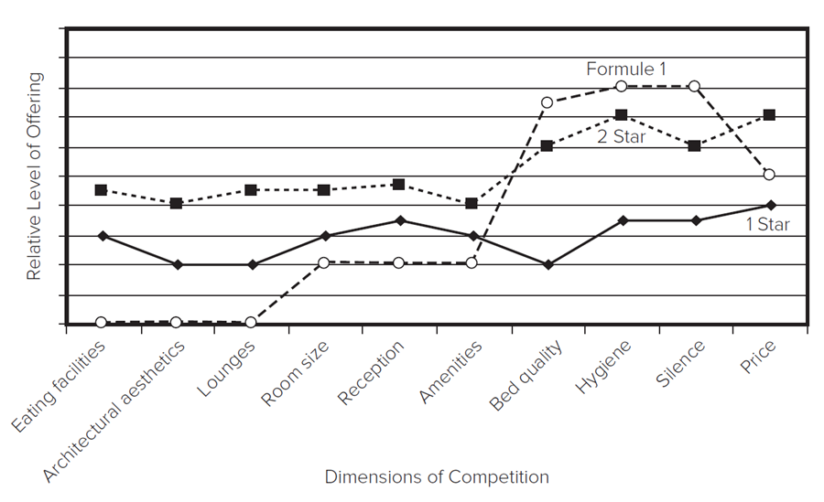
Research Brief: Blue Ocean Strategy 2
Managers can challenge the industry industry’s strategic logic by asking the following four questions:
Which of the factors that the industry takes for granted should be eliminated?
Which factors should be reduced well below the industry’s standard?
Which factors should be raised well above the industry’s standard?
Which factors should be created that the industry has never offered.
Access the text alternative for these images.

Slide 18
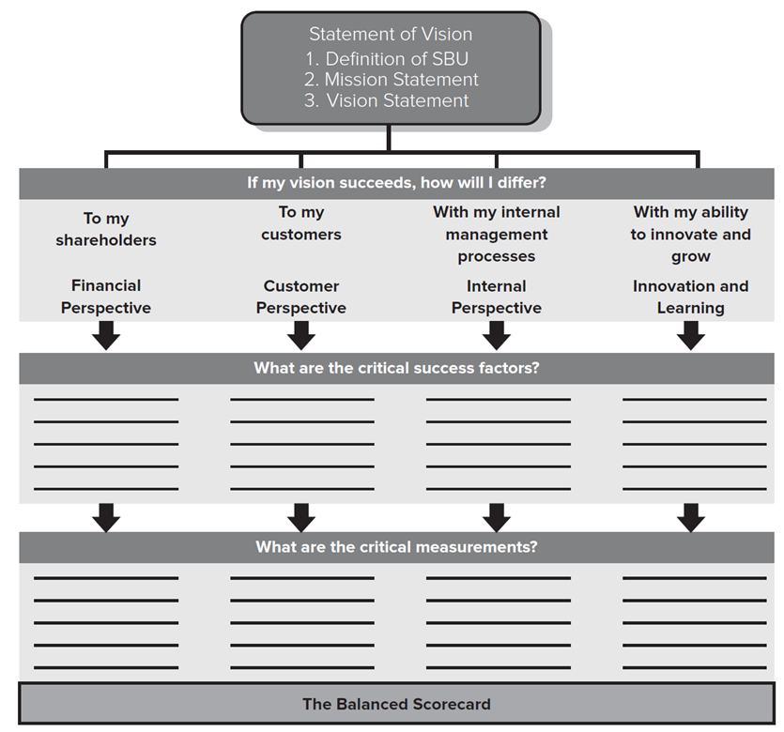
Theory In Action
The Balanced Scorecard.
Kaplan and Norton argue that effective performance measurement should incorporate:
Financial perspective.
Customer perspective.
Internal perspective.
Innovation and learning.
Source: R. Kaplan and D. Norto, “Putting the Balanced Scorecard to Work,” Harvard Business Review, September–October 19 93.
Access the text alternative for these images.

Slide 19
Discussion Questions
What is the difference between a strength, a competitive advantage, and a sustainable competitive advantage?
What makes an ability (or set of abilities) a core competency?
Why is it necessary to perform an external and internal analysis before the firm can identify its true core competencies?
Pick a company you are familiar with. Can you identify some of its core competencies?
How is the idea of “strategic intent” different from models of strategy that emphasize achieving a fit between the firm’s strategies and its current strengths, weaknesses, opportunities and threats (S W O T)?
Can a strategic intent be too ambitious?

Slide 20
Supplementary Video
A Short Video on:
Innovation Strategy: Porters 5 Forces Plus.
https://youtu.be/W0hySWGHKj4

Slide 21
End of Main Content
© McGraw Hill LLC. All rights reserved. No reproduction or distribution without the prior written consent of McGraw Hill LLC.

Slide 22
Accessibility Content: Text Alternatives for Images

Slide 23
Assessing the Firm’s Current Position 3 –Text Alternative
Return to parent-slide containing images.
Five pentagons representing the bargaining power of suppliers, the threat of potential entrants, the bargaining power of buyers, and the threat of substitutes are point toward a square at the center representing degree of existing rivalry. A square labeled the role of complements, points to the central square.
Return to parent-slide containing images.

Slide 24
Assessing the Firm’s Current Position 4 – Text Alternative
Return to parent-slide containing images.
Double headed arrows from a list of stakeholders pointing toward a circle at the center representing Firm. Ovals representing stakeholders read as follows: Customers, employees, stockholders, lenders, rivals, suppliers, government, and the local community.
Return to parent-slide containing images.

Slide 25
Assessing the Firm’s Current Position 5 – Text Alternative
Return to parent-slide containing images.
A box representing Primary Activities is on the left above which another box represents Support Activities. Inbound logistics, operations, outbound logistics, marketing, and service are listed as primary activities from left to right. Infrastructure or administration, H R management, technology development, and procurement are listed as support activities from top to bottom. Boxes representing each of the support activities extend along the length of all primary activities together.
Return to parent-slide containing images.

Slide 26
Identifying Core Competencies and Capabilities 2 – Text Alternative
Return to parent-slide containing images.
Boxes representing Competence 1 and Competence 3 are point toward a box representing Core Product 1. Two other boxes representing Competence 2 and Competence 4 point toward a box representing Core Product 2. Core Product 2 leads to four ovals representing Business 1, Business 2, Business 3, and Business 4. Each of the ovals represent Business 1, 2, 3, and 4 lead to three other circles representing end products 1 through 3, 4 through 6, 7 through 9, and 10 through 12, respectively.
Return to parent-slide containing images.

Slide 27
Strategic Intent – Text Alternative
Return to parent-slide containing images.
Resource and capability gap lead to resources and capabilities underlying current position, that is the firm's current position and resources and capabilities necessary for future position, that is the firm's desired future position.
Return to parent-slide containing images.

Slide 28
Research Brief: Blue Ocean Strategy 2 – Text Alternative
Return to parent-slide containing images.
Eating facilities, architectural aesthetics, lounges, room size, reception, amenities, bed quality, hygiene, silence, and price are marked on the x axis. Some of the points of the 1 star line chart are as follows: Eating facilities, 3. Architectural aesthetics, 2. Price, 4. Some of the points of the 2 star line chart are as follows: Eating facilities, 4.5. Architectural aesthetics, 4. Price, 7. Some of the points of the formula 1 are as follows: Eating facilities, 0. Architectural aesthetics, 0. Price, 5.
Return to parent-slide containing images.

Slide 29
Theory In Action – Text Alternative
Return to parent-slide containing images.
Statement of vision is divided into a question, if my vision succeeds, how will I differ? To my shareholders, financial perspective, downward arrow. To my customers, customer perspective, downward arrow. With my internal management processes, internal perspective, downward arrow. With my ability to innovate and grow, innovation and learning, downward arrow. All the above lead to a question, what are the critical success factors, with 5 blank lines and downward arrows in four columns. All the above lead to a question, what are the critical measurements, with 5 blank lines and downward arrows in four columns. Below it, the balanced scorecard is shown.
Return to parent-slide containing images.

